Slide 1


SAHAJA YOGA MEDITATION
  WELCOME!
  www.freemeditation.com.au

Slide 2
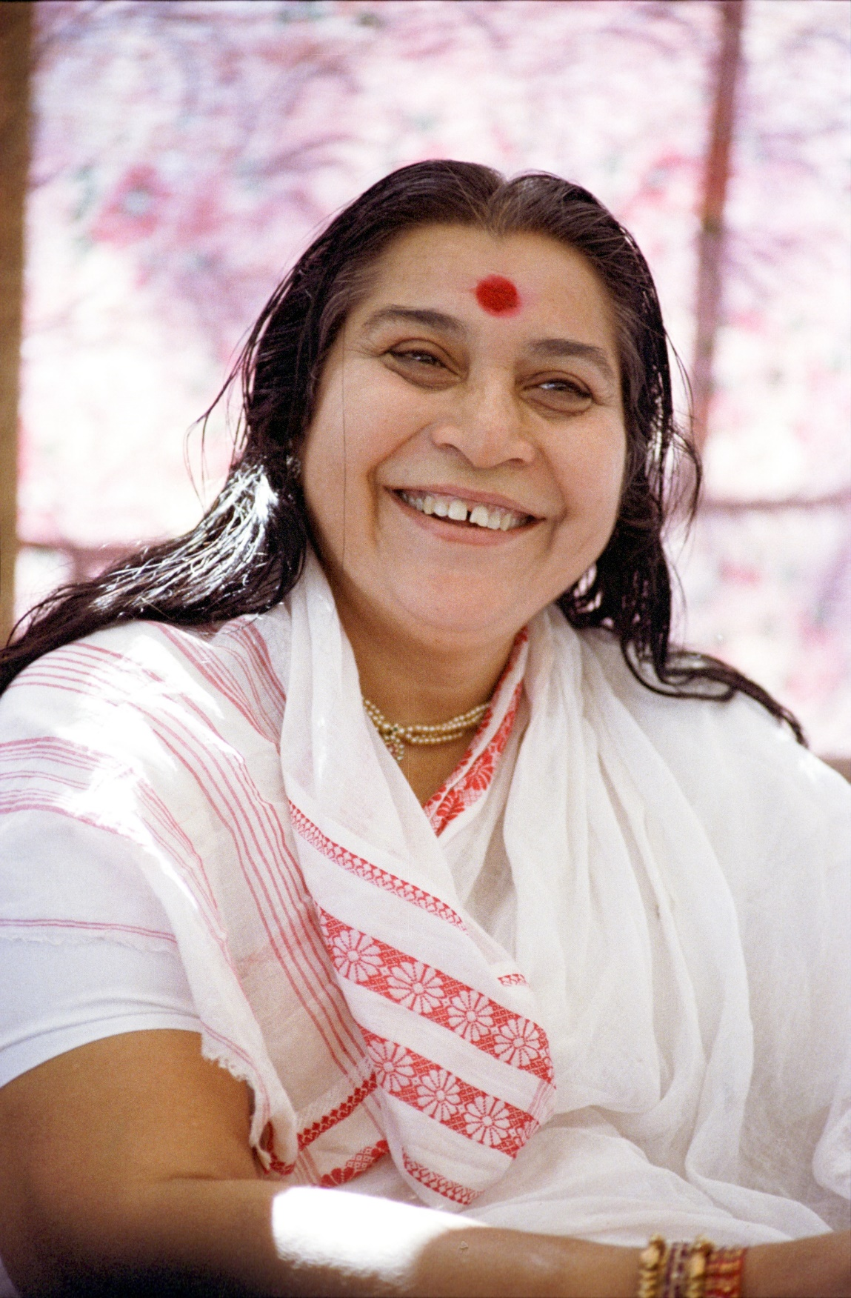
Shri Mataji Nirmala Devi
Founder
Founded Sahaja Yoga Meditation in 1970 in India
She has given this knowledge free of cost to the whole world
Sahaja Yoga is now practiced in more than 150 countries.
Shri Mataji Nirmala Devi

Slide 3
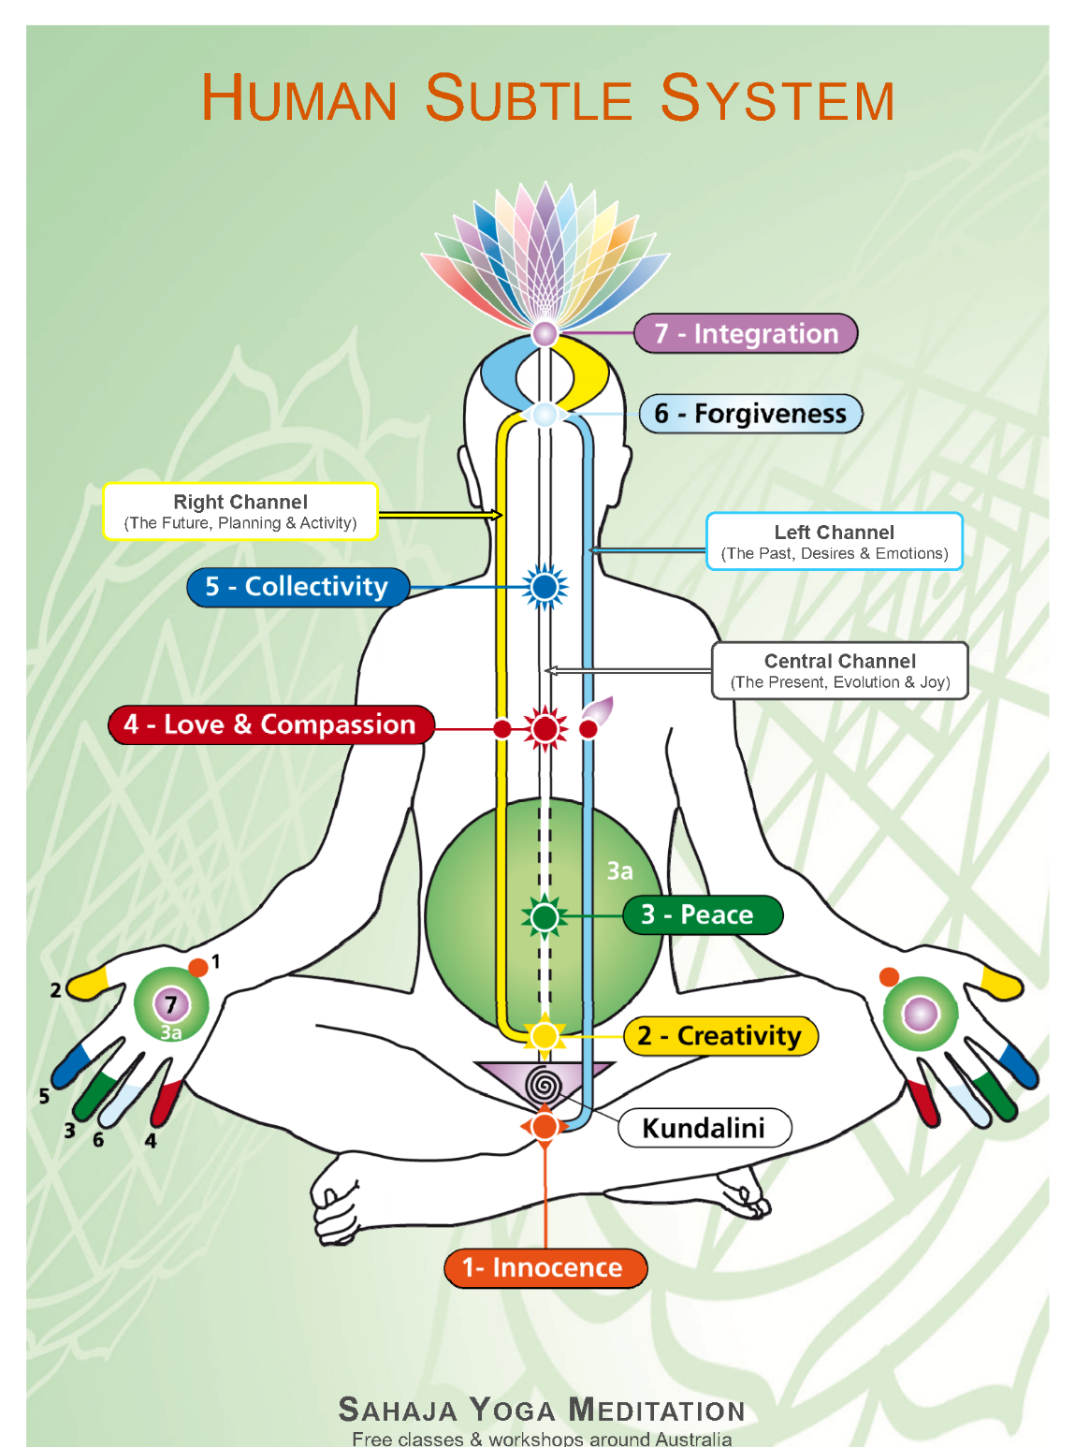
Experience a state called thoughtless awareness- go beyond the mind and feel connected to the power/energy around you. This is true meditation
Shri Mataji Nirmala Devi (Nirmala Srivastava), founder of Sahaja Yoga Meditation in 1970

Slide 4
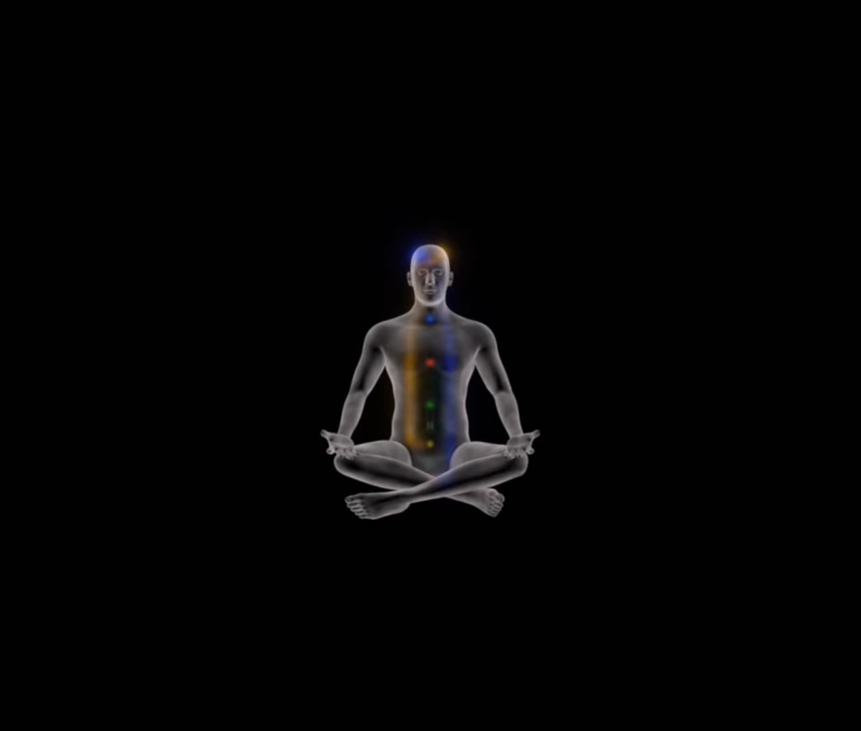
Subtle System Science

Slide 5


Self- Realisation

Slide 6
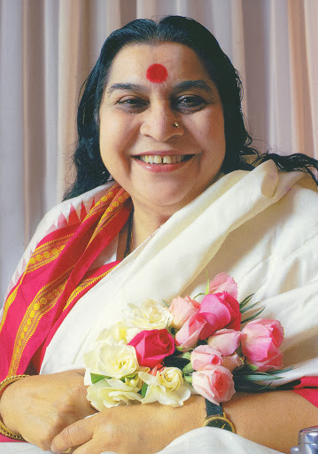
Please remove your footwear
Take of your glasses and
Sit comfortably with your hands in your lap, palms facing upwards.

Slide 7
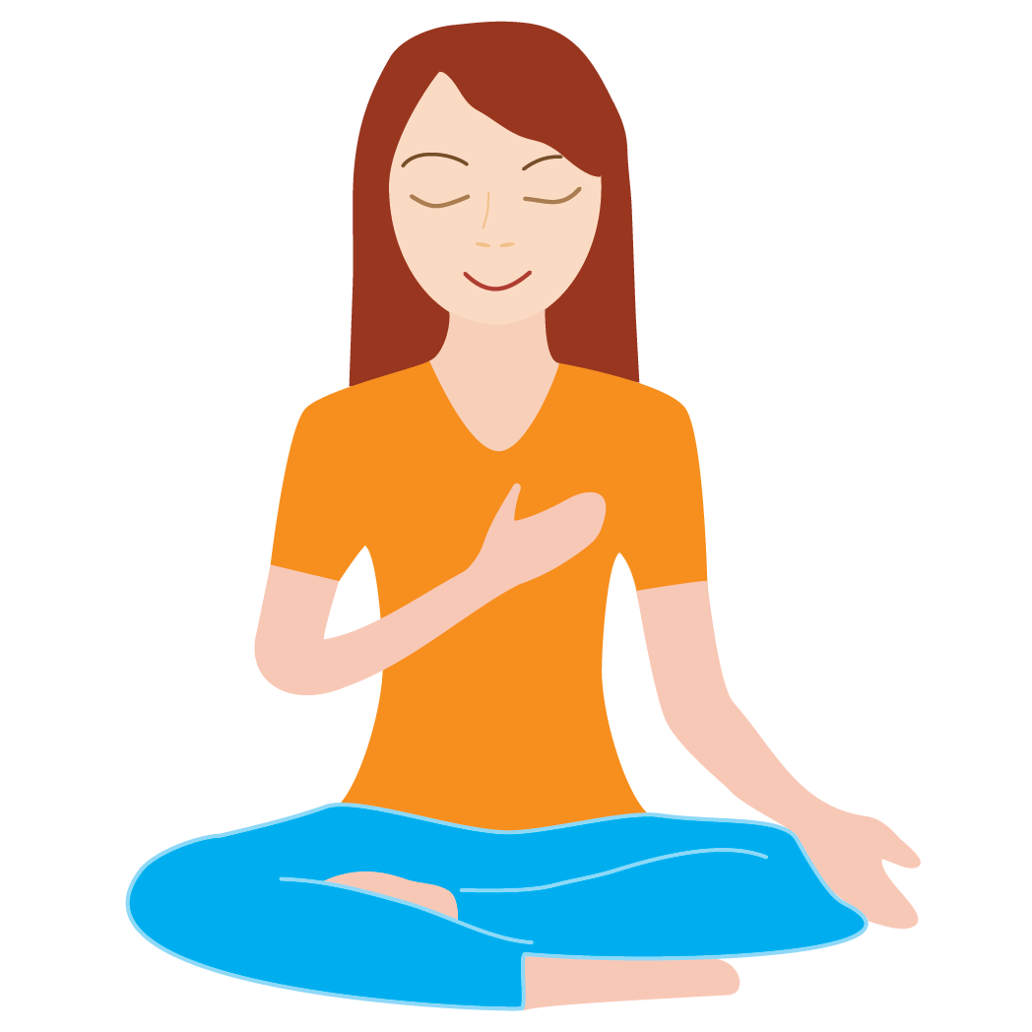
With your right hand on your heart. Ask your Motherly (Kundalini) energy three times.
“Mother, am I the spirit?”

Slide 8
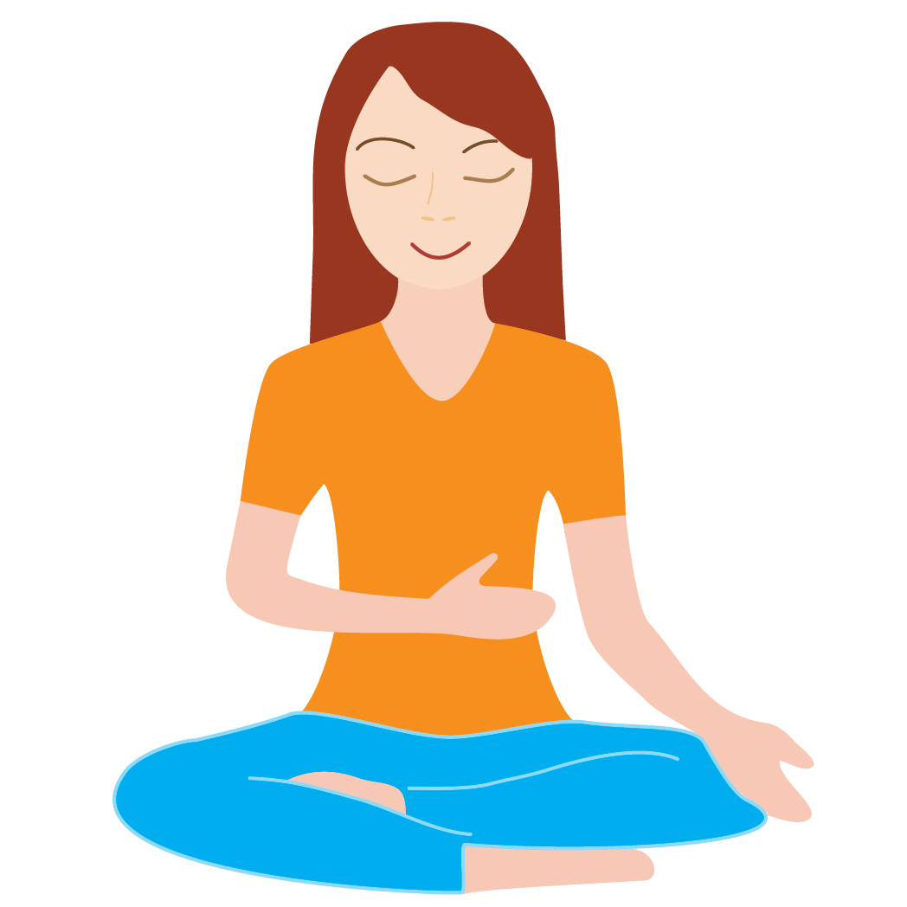
Right hand on your upper stomach on the left side, just below the ribs, ask three times
“Mother, am I my own Master?”

Slide 9
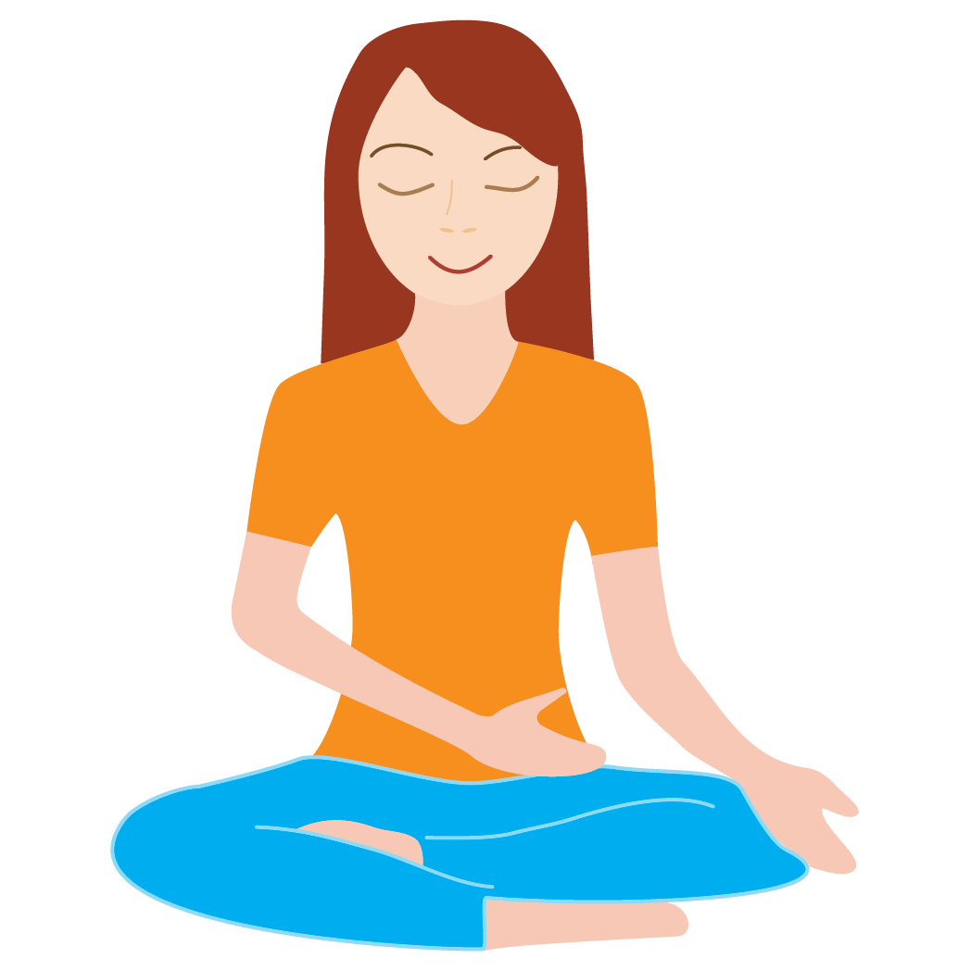
Right hand on your left lower stomach, where the leg joins the torso, ask six times
“Mother, please give me the pure desire”
“Mother, please give me the pure knowledge”

Slide 10
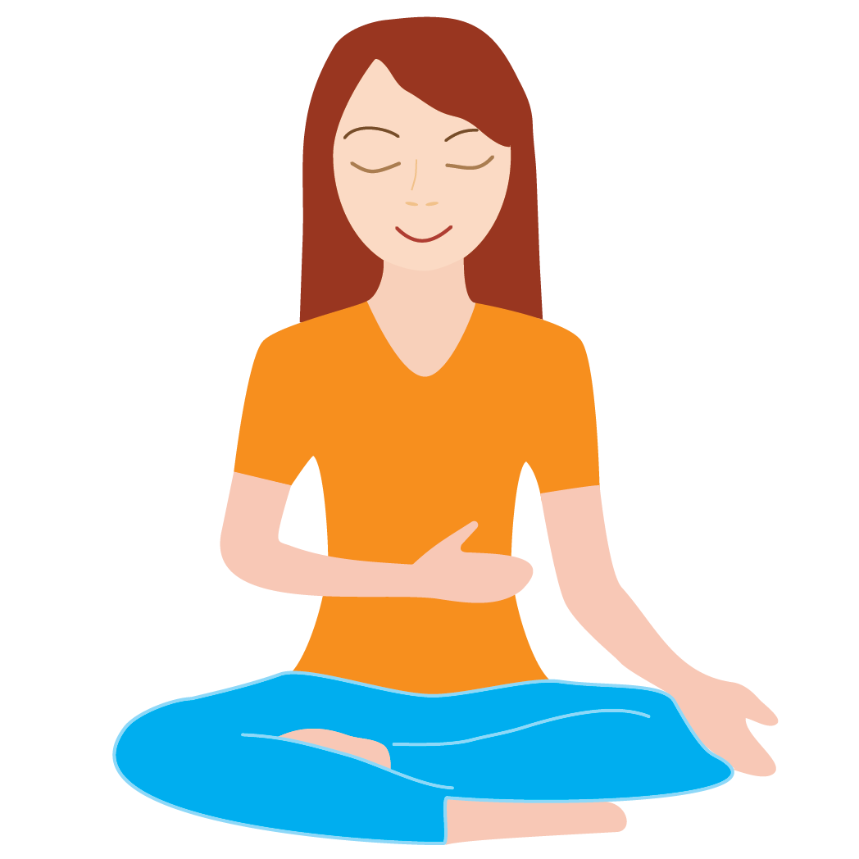
Return the right hand back on your upper stomach on the left side below the ribs and say confidently 10 times
“Mother, I am my own Master”
“Mother, I am my own Guru”

Slide 11
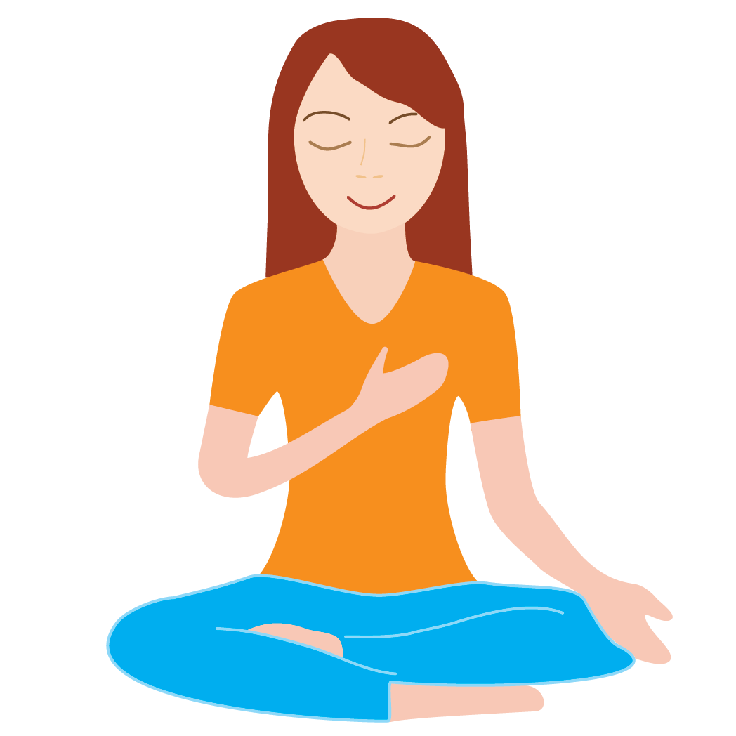
Return right hand on your heart. Say confidently twelve times
“Mother, I am the spirit”

Slide 12
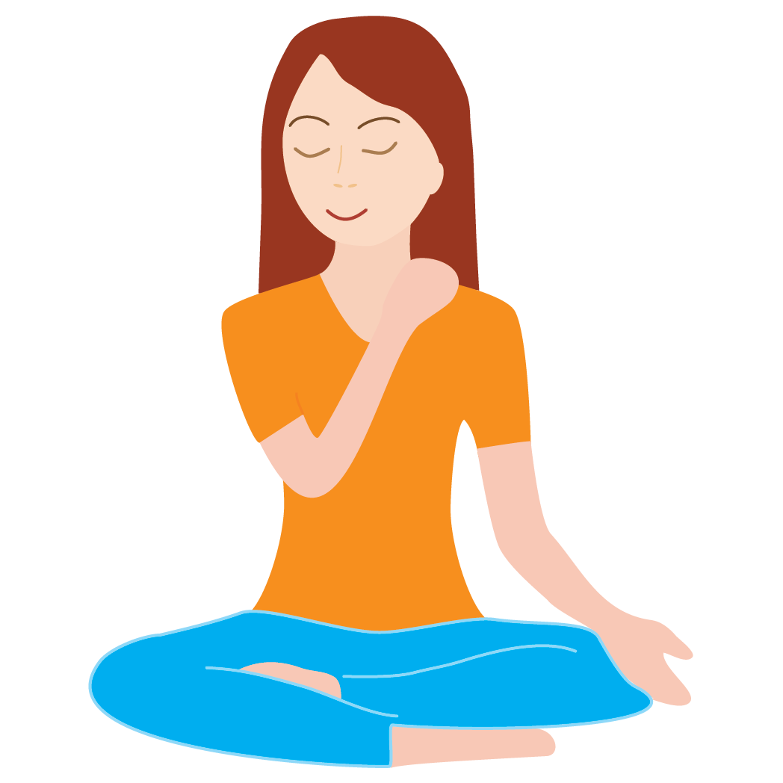
Right hand on the left side where shoulder meets the neck. Turn the head slightly to the right and say sixteen times
“Mother, I am not guilty”

Slide 13

Place your right hand across the forehead, gently grasping the temples, and say from the heart
“Mother, I forgive everyone”
“Mother, I forgive myself”

Slide 14

Place your right hand on the back of your head and tilt the head slightly upwards towards the sky and say for your own satisfaction
“Mother, please forgive me for any mistakes that I may have made against my spirit”

Slide 15

Stretch the fingers of your right palm. Place the centre of your palm on the top of your head on the fontanel area, slowly rotate clockwise and ask seven times
“Mother, please give me my Self Realisation”

Slide 16
Put your hands back in your lap
Take your attention above your head and enjoy the mental silence inside.
If any thoughts come into your head just say I forgive, I forgive and watch them go away..

Slide 17
Take your right hand and hold it a few inches above your head and see if you can feel any coolness or heat coming out of your head
Move your hand around and try and feel any sensation and hold your hand in that position.
Put your attention where your hand is..

Slide 18
Put your hands back in your lap
And try and feel again using your left hand

Slide 19
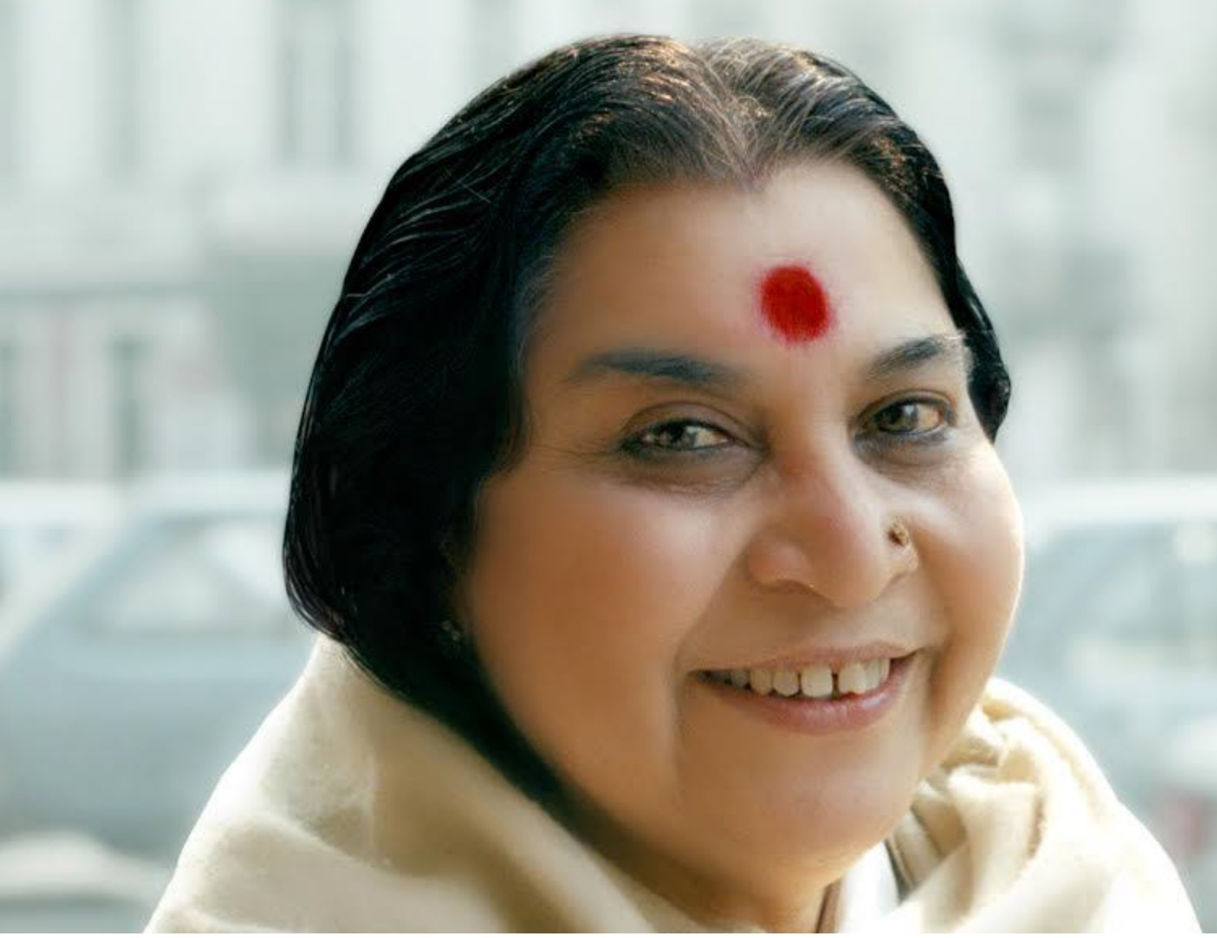

Let’s Meditate…

Slide 20
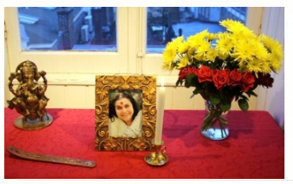

Slide 21
What's Next?
Meditate daily at home using shared guidelines
Register here if haven’t done before
Visit our website on www.freemeditation.com.au for more information and daily meditation webcasts

Slide 22
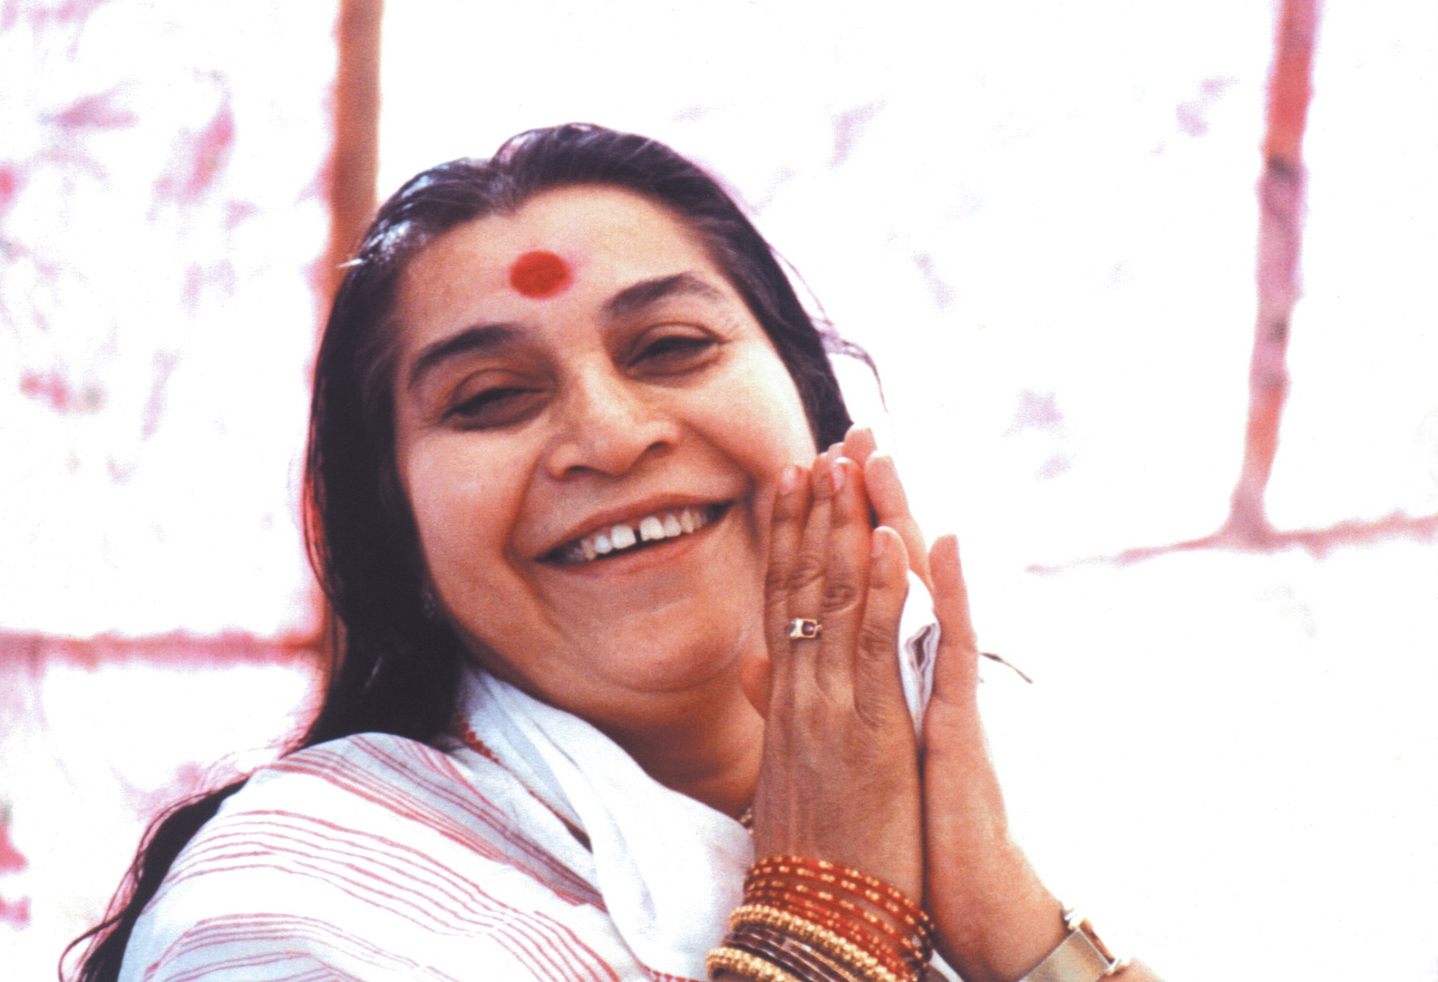
Thank you!

